Slide 1
BROSIX
Presentation

Slide 2
Contemporary Communication
Today business needs a communication that is:
Fast – connects us quickly without delays
Reliable – works always
Global – connects us with the whole world
Low cost to use
Low cost to manage
Protected – the information exchanged remains protected and available only for the recipient

Slide 3

BROSIX is a communication and collaboration tool suitable for everyday business.
You can easily create your own communication network with a high security level of all communication channels and access control.

Slide 4
BROSIX is a communication and collaboration tool suitable for everyday business.
Improves productivity
Secures confidential information

Slide 5
Features
Text Chat
File Transfer
Voice Chat
Video Chat
Co-Browse
Whiteboard
Screen-shot
Screen-sharing

Slide 6
More Features
Strong encryption of all communication channels
Peer-to-peer technology for faster transmission
Globally distributed server system
Intuitive User Interface
GUI Themes
Multiple Languages

Slide 7




Works on
Mac
Android
Linux
iPhone / iPad
Windows

Slide 8
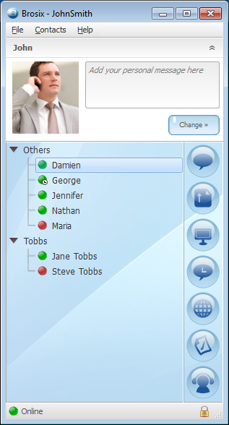
The Main Window
Shows which employees are online
Group the employees by departments
Easy access to the application main features

Slide 9
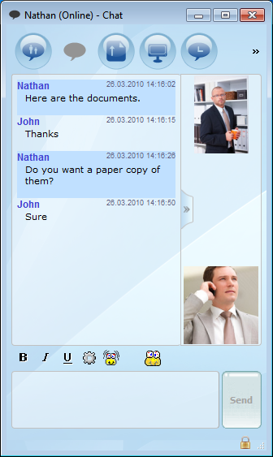
Text Chat
Easy for work chats with colleagues
Easy access to the main application features
All messages exchanged between the users are logged on the server
Secured communication channel

Slide 10
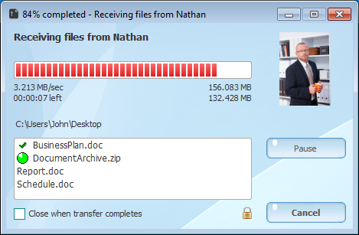
File Transfer
Fast speed of file transfers
Secured communication channel

Slide 11
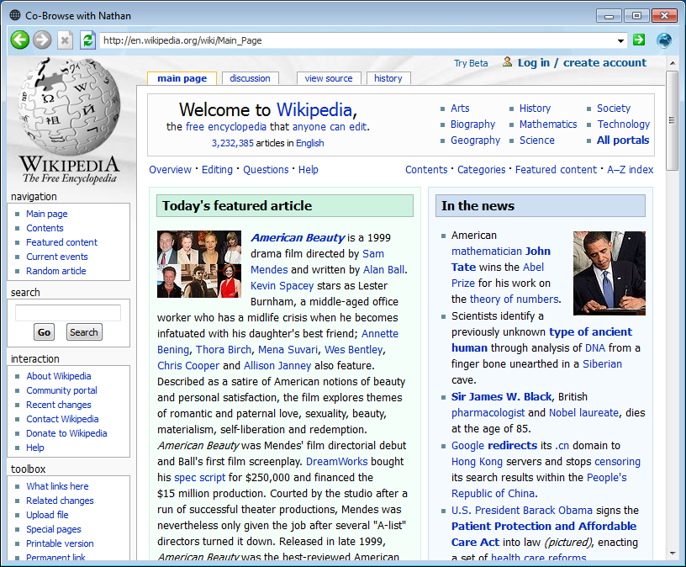
Co-Browse
Cooperative web Browsing

Slide 12
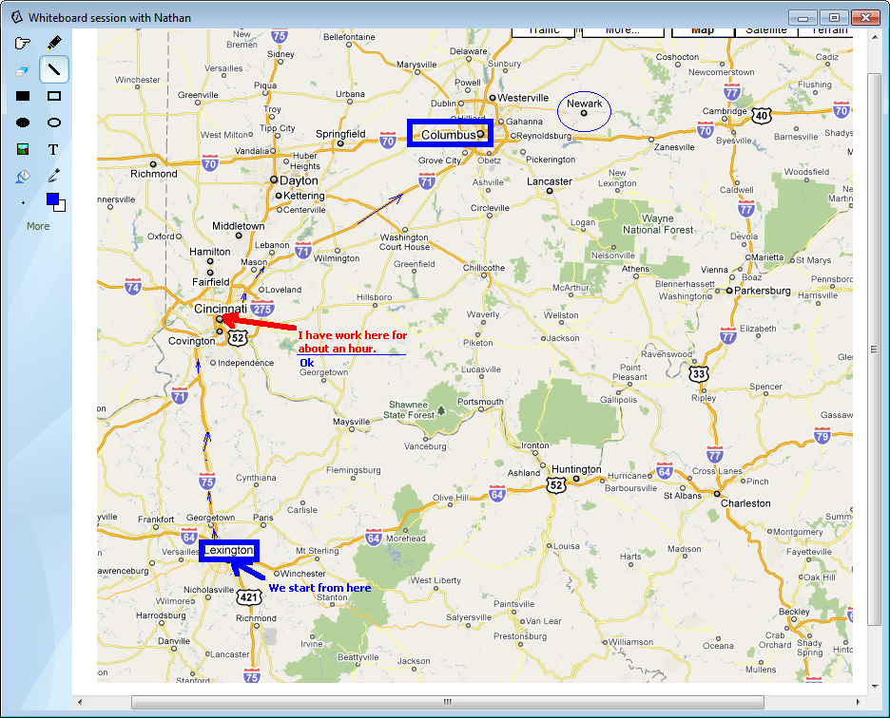
Whiteboard
Cooperative drawing of charts and diagrams
Secured communication channel

Slide 13
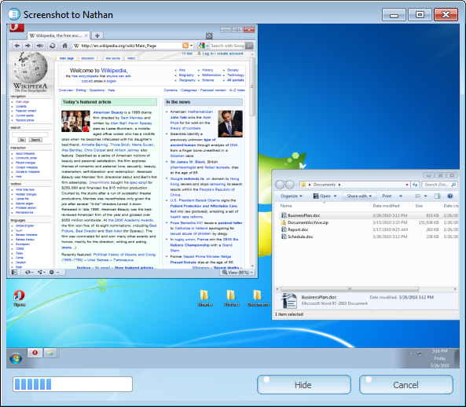
Screenshot
Very easy to show what is happening on the computer screen.
Secured communication channel

Slide 14
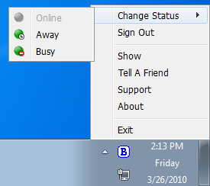
Tray Icon
Shows the status change
Easy access to major features

Slide 15
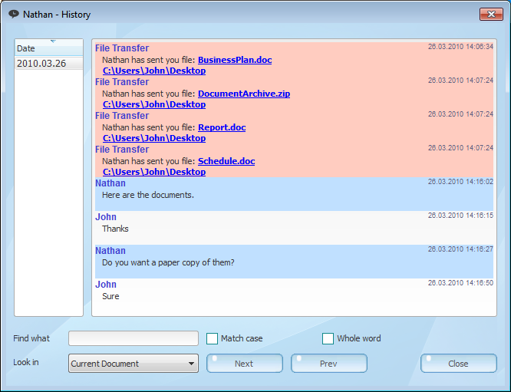
History
Local history of all communication with each user
Searching
Grouped by users

Slide 16
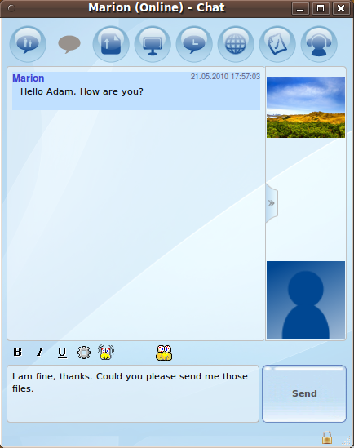
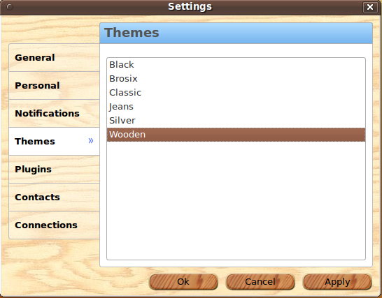
Themes for different view

Slide 17
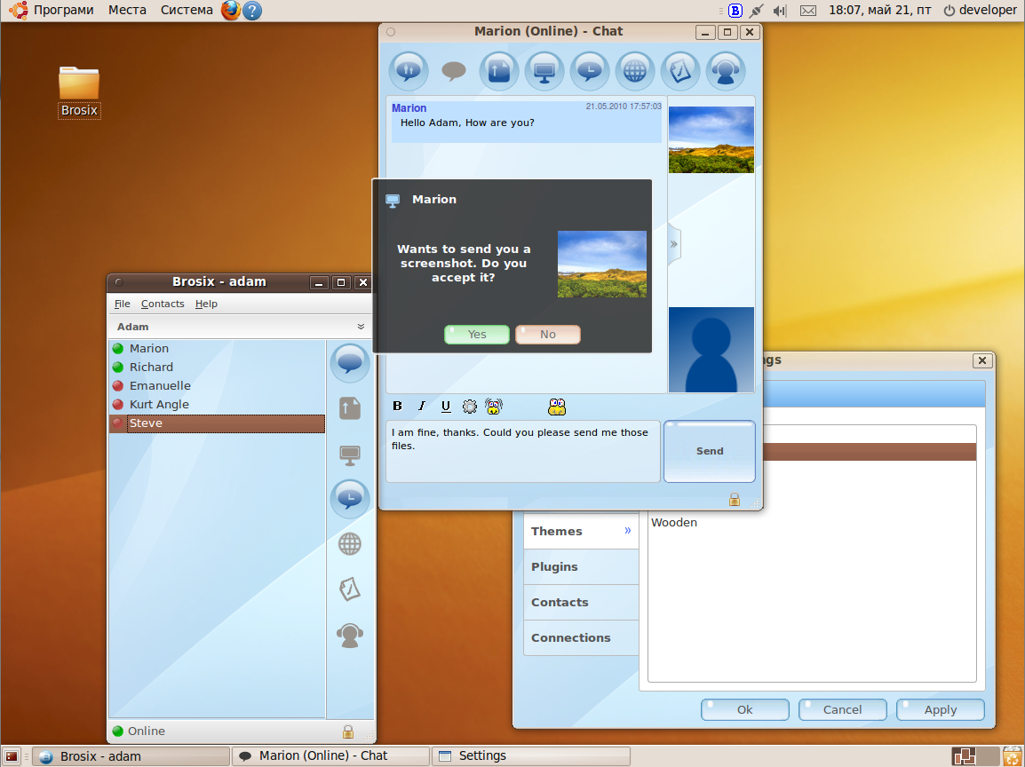
This is how it looks on Linux...

Slide 18
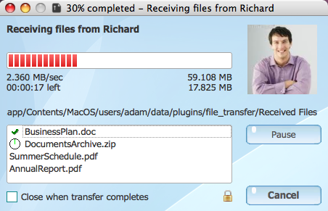
This is how it looks on Mac...

Slide 19

Connects thousands of users all over the world

Slide 20

Special features for businesses

Slide 21
Private communication network
Rich set of collaboration features
Works in LAN, via VPN and in the Internet
Encryption and securing of all communication channels
Full control over the whole network

Slide 22

Full control over the whole network
Control the users – add new, delete
Control connections – set communication rules between users
Control features – set which features can use a user
Full log of all user communications

Slide 23
What are the benefits?
Low cost to communicate between offices in different cities and countries. Uses the existing low cost Internet infrastructure.
Data protection when data is exchanged between offices in different cities and countries.
Rich set of features that improve productivity.
Control employees contacts that improves their efficiency and reduces the risk of confidential information leak.
Detailed log of each employee communication to improve the company data protection.

Slide 24
BROSIX is a communication and collaboration tool suitable for everyday business.
You can easily create your own communication network with a high security level of all communication channels and access control.

Slide 25
BROSIX is a communication and collaboration tool suitable for everyday business.
Improves productivity
Secures confidential information

Slide 26
To contact:
www.BROSIX.com

Slide 27
Thank you for your attention!

